Slide 1
Visualization for Audience Performance
ALY6980 21078 Capstone SEC 05 Winter 2020 CPS [VTL-1-OL] ALY6980.21078.202025
Student: Srinivasu Narahari
Professor: Matt Goodwin, Ph.D.

Slide 2
Executive Summary
(James, G. (2020, Feb 24).) Viacom wants to understand if they are reaching the right audience on their social media channels by analyzing the performance of various ad campaigns that target various audiences. Provided analysis using real-world data to understand what drives success in reaching the right audience for the right objective. Analysis results show that Viacom parameters like impressions, clicks, cpm, ctr variation is not much with the data. It is reflecting that Viacom rampaging to right audience.

Slide 3
Agenda (examples.com. (n.d.))
Learning Viacom Introduction
Defining the Statement of the problem
Narrow down the Purpose of the study
Research questions hypotheses or goal
further experiments to be run
Review of the literature
List Methods to get solution the problem
Data collection instruments, variables, and materials
Data analysis procedures
Conclusion

Slide 4
About Viacom
Viacom is an entertainment company and creates media content. The content created by Viacom is delivered in Television channels. Viacom planned to increase the business. Viacom also uses content for promoting in social media like Facebook and twitter. Based on the user history and demographic information Viacom targets content to those user groups, by this way targeted audience enjoy the content.
Viacom wants to understand if they are reaching the right audience on their social media channels by analyzing the performance of various ad campaigns that target various audiences. Provide analysis using real-world data to understand what drives success in reaching the right audience for the right objective

Slide 5
Introduction
Analyze the performance of Viacom content across the various audience types and how much does it cost to target them. The following topics are considered for Analyzing.
• Like how many impressions
• Video views
• Engagements have these audiences accrued
• How many times have the audiences been targeted for various ad campaigns?
Analyze and understand the size of the audiences and how that may relate to performance of given ad campaigns by optimize the following topics.
• Total impressions
• Total reach (unique impressions)
• Total video views
• Total engagements
• Engagement rate (engagements/impressions)
• High video retention low cost

Slide 6
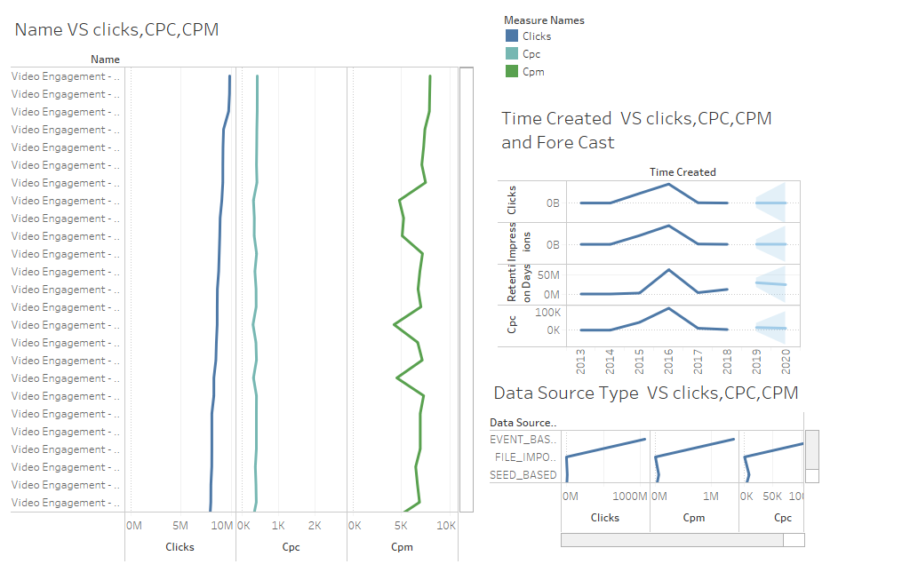
Dash Board (Frye, C. (2015, 9 9))

Slide 7
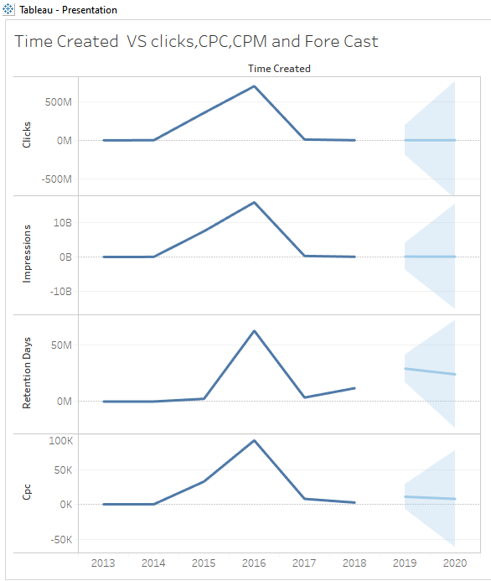
Time Create effects on the CPC, CPM, Clicks
This graph shows the effect of the Time on different factors like CPI,CPM or clicks. By seeing the plots all are having the same effect on the time created. Viacom has better performance during the year 2016. From 2017 it performed quite steadily.
Fore cast for the feature also showing steadiness.
Retention days decreased in 2017 and increasing steadily in the immediate past.

Slide 8
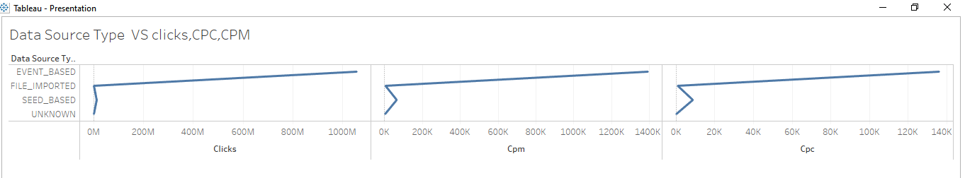
Effect of Data source Type on Clicks, CPM,CPC
In all Data Source Types Event based Source type is most effective
Seed based has minor impact on the Clicks, CPM, CPC
The Effect of Event type is almost same on the clicks ,CPM and CPC

Slide 9
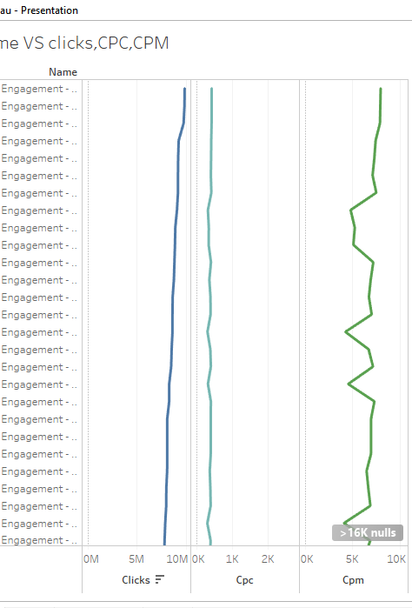
Name of the Video effects on the clicks, cpc , cpm.
Name of the video on the clicks and CPC is minor.
Name of video on CPM is changing as per name.

Slide 10
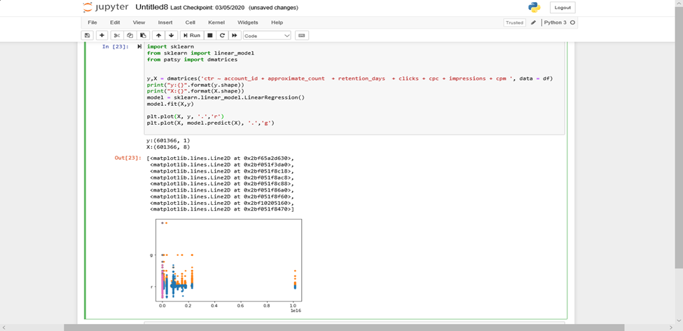
Build models of linear variation of CPM, CRT, Impressions, clicks. The following screen shot shows the linear variation ctr with other parameters of the data

Slide 11
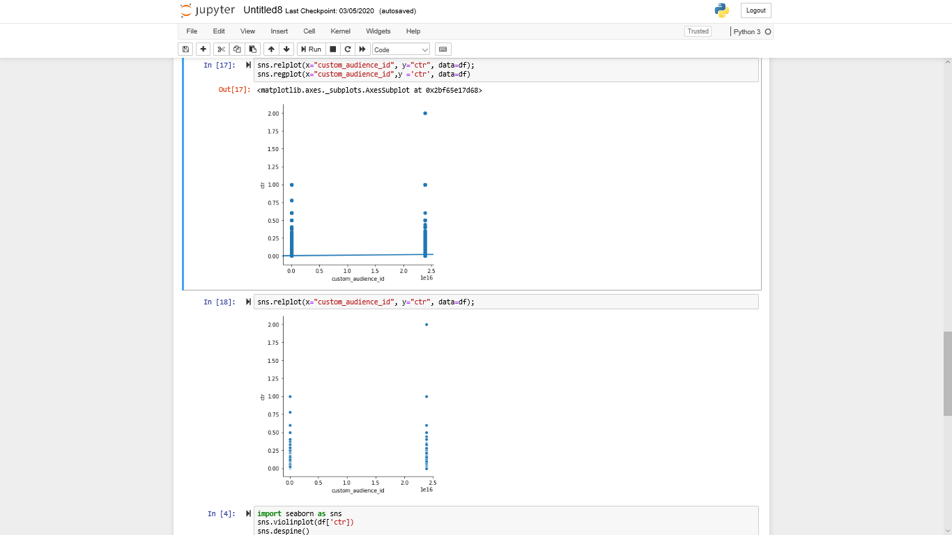
The following graph shows linear relation between account id and Ctr.

Slide 12
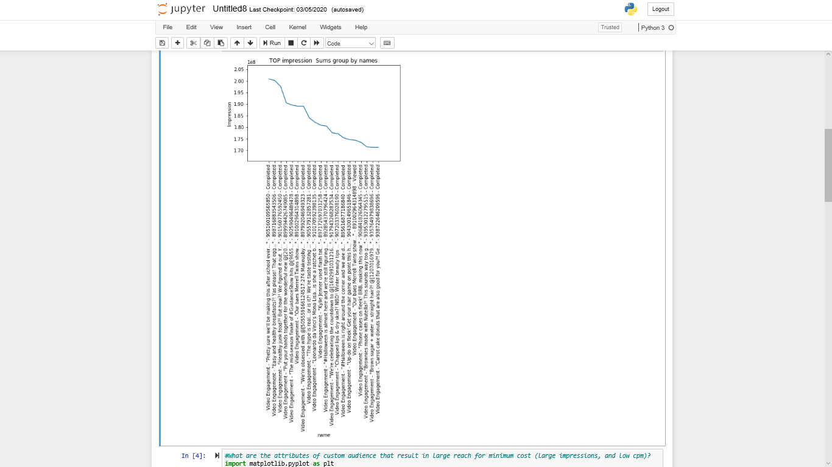
Plotted few graphs for tracing the variation CPM, CRT, Impressions, clicks.

Slide 13
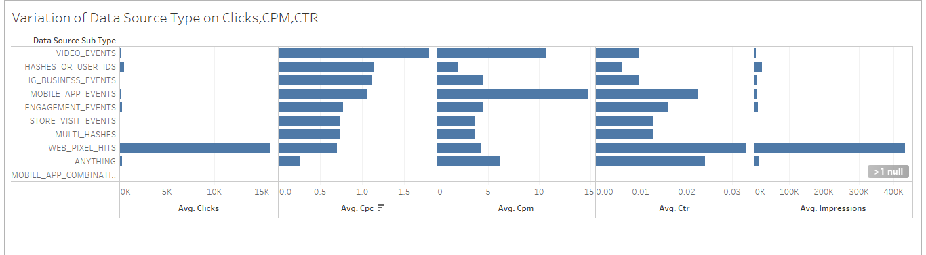
Variation of Data Source Type on Clicks , CPM, CTR

Slide 14
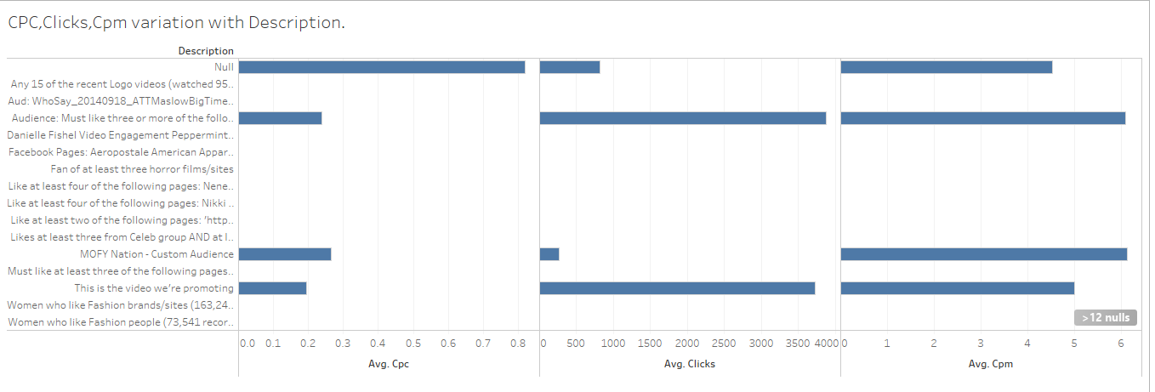
CPC ,Clicks , CPM variation with Description.
Audience must like 3 or following pages and MOFY Nation Custom Audience, This is the video we are promoting has major effect on CRT,CPM, Clicks.

Slide 15
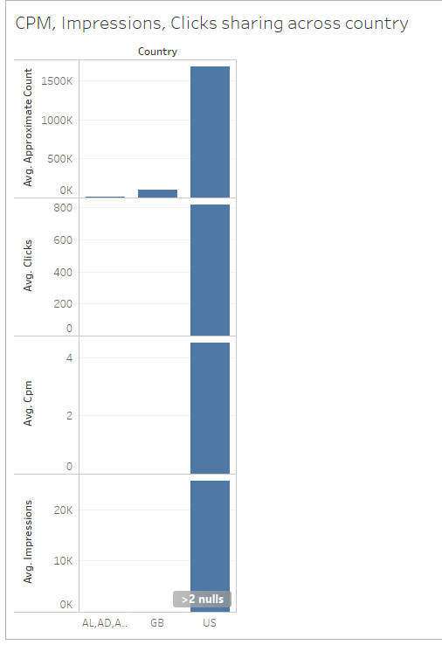
CPM, Impressions, Clicks sharing across country
US is the Origin county is for many programs.
GB is origin for few programs
Viacom is not receiving any clicks or impressions.
GB has little effect on approximate account.

Slide 16
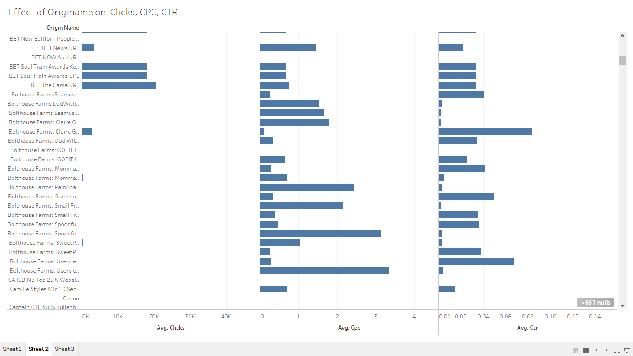
Effect of Original name on Clicks, CPC, CTR

Slide 17
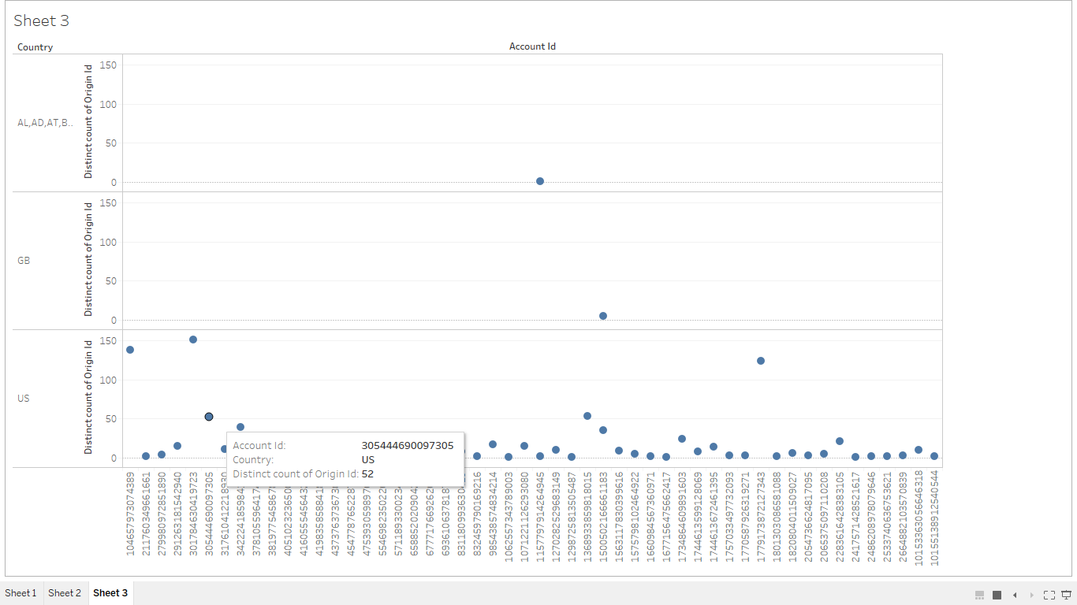
Country, Account and Origin Id count relation

Slide 18
Findings
The Time on different factors like CPI,CPM has the same effect on the time created. Viacom has better performance during the year 2016. From 2017 it performed quite steady.
Forecast for CPM, CRT, Impressions, clicks shows steadiness of their effect on performance.
Retention days effect decreased till 2017 and increasing steadily in the immediate past.
In all Data Source Types Event based Source type is most effective
Seed based has minor impact on the Clicks, CPM, CPC
The Effect of Event type is almost same on the clicks ,CPM and CPC
There is linear relation between account id and Ctr.
Name of the video on the clicks and CPC is not much. Name of video on CPM is changing as per name.
Name of the video on the clicks and CPC is minor. Name of video on CPM is changing as per name

Slide 19
Recommendations
Continue focusing on the same way will help to improve business. Viacom forecast curves are increasing sturdily.
Viacom doing better business with web pixel hits ,mobile app events and video events.
Increase shows of event based type.
Viacom doing good business they needs to focus on other countries

Slide 20
Limitations
Nulls are not removed. Data files provided are used as it is.
Could not complete clustering of the date due to time and complexity.
Model is build by considering few fields. Could not consider all the columns.
We can do more analysis on the lookalike data joined with custom audience add data.

Slide 21
References
James, G. (2020, Feb 24). How to Write a Compelling Executive Summary. Inc. Retrieved from https://www.inc.com/geoffrey-james/how-to-write-a-compelling-executive-summary.html
Guzenko, I. (2019). CPC, PPC, CPM, CPI, CPA, CPL: Which Online Ad Models Are Best? . Smartyads. Retrieved from https://smartyads.com/blog/cpc-ppc-cpm-cpi-cpa-cpl-which-online-ad-models-are-best/
Creswell, J. W. (2017). Research Design: Qualitative, quantitative, and mixed methods approaches. Retrieved from https://northeastern.blackboard.com/bbcswebdav/pid-13483009-dt-message-rid-69266389_1/xid-69266389_1
Frye, C. (2015, 9 9). Lynda. Retrieved from Tableau 9 Essential Training: https://www.lynda.com/Tableau-tutorials/Tableau-9-Essential-Training/386886-2.html?org=neu.edu
examples.com. (n.d.). How to Write an Agenda. Examples. Retrieved from https://www.examples.com/business/how-to-write-an-agenda.htm

